Slide 1
Understanding the Significance of Quality Attributes in Software Development
D7032E – Josef Hallberg

Slide 2
Outline
Availability in practice
Modifiability in practice
Integrability in practice
Testability in practice (we have a session with Försäkringskassan this afternoon)
Performance in practice

Slide 3
Example: Mobile safety button
Fall-detector
Triggers alarm
Sends GPS position to carer
Verbal instructions to calm patient
Live communication if possible
Verbal instructions to onlookers
Special conditions, medicine, CPR, etc.

Slide 4
What needs to be available at all times?
Features, Functions, Degraded functions…?

Slide 5
Implications in code?
Architectural elements, System / Hardware, Sourcecode?

Slide 6


Modifiability

Slide 7
Modifiability in a game that lives decades?
Sepration of concerns – Modular design
Graphics engine
Game engine
Game mechanisms
Quests and Story
UI and Controls
Modifiability from a Performance and Scalability perspective
Bottlenecks scale independently of game mechanisms

Slide 8

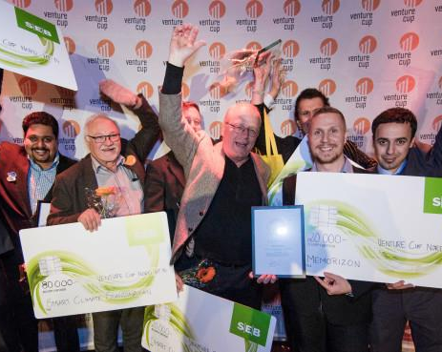
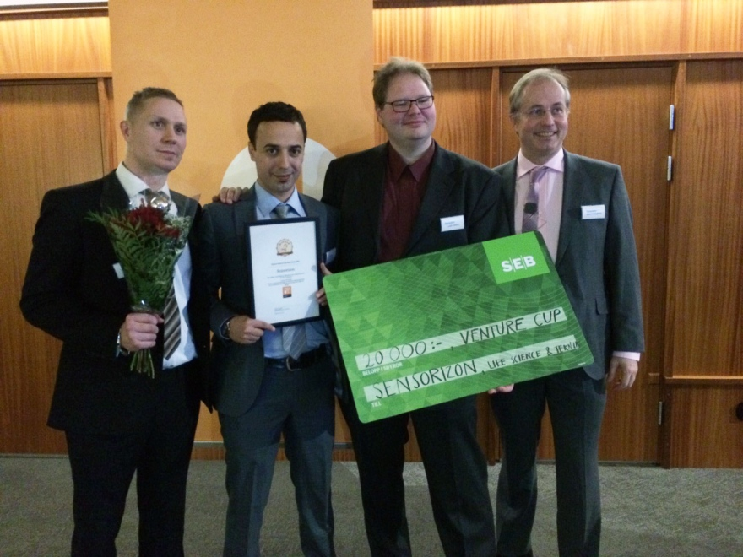
Consequences of overdoing modifiability
Memorizon won Venture Cup 2014
Sensorizon won Venture Cup 2015

Slide 9
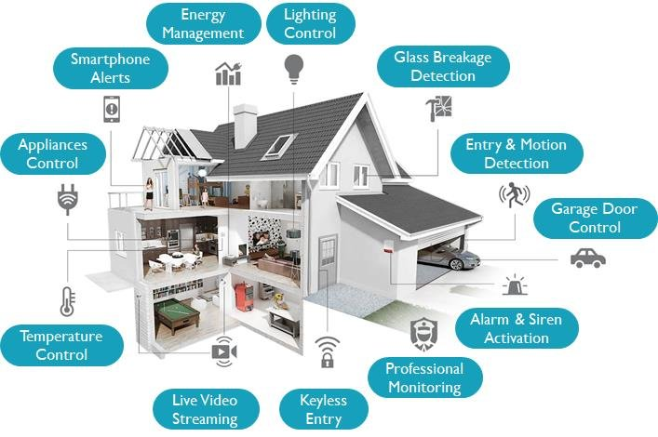
Integrability – Smart Home technology – Why it’s not more popular
Benefits:
Safety, Sustainability, Convenience, etc.
Problems:
Different systems = many apps
A lot of data, few services
Trust, privacy, security
Requires a lot of hands-on to work

Slide 10

How we wished our technology just worked

Slide 11
How do we achieve integrability?
Consequences for software architecture and sourcecode?

Slide 12





Performance…

Slide 13
Predicting performance needs
How? What architectural, system, and sourcecode implications?

